Slide 1
Weather Prediction System
By: Kelvin Lin, Ming Su, Joe Lin, Karen Wang

Slide 2
What’s the problem?
A farmer’s livelihood is dependent on their ability to grow crops.
This is hard when factors beyond their control – like weather – get in their way.

Slide 3
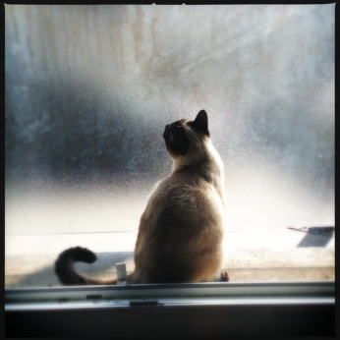
Current Solutions
Look outside the window.
Problem?
By the time you see bad weather, it’s too late to do anything!
Notes:
https://pixabay.com/p-361895/?no_redirect

Slide 4
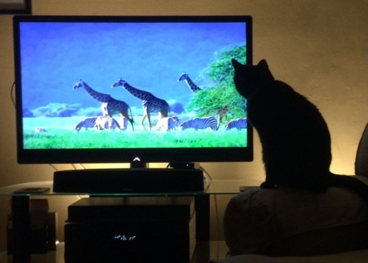
Current Solutions (2)
Check the weather network.
Problem?
Some farms are huge and far away from weather stations. Their predictions may not be accurate!
Notes:
https://c1.staticflickr.com/8/7426/16268801077_d49e274d6d_b.jpg

Slide 5
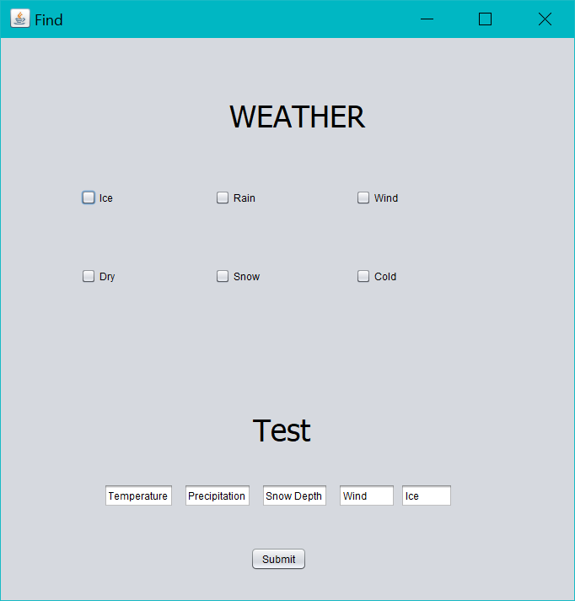
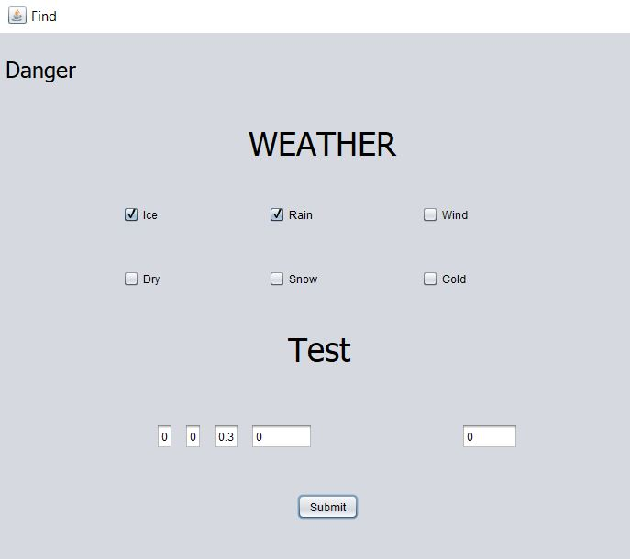
Introducing the Weather Prediction System!

Slide 6

What is the Weather Prediction System?
The weather prediction system helps farmers by providing customized predictions so farmers know what’s coming!

Slide 7
How is this done?
The weather prediction system uses machine learning technology as well as open datasets to make informed predictions about the future.

Slide 8
Finding the Data
First, we determined the criteria for safe and dangerous weather conditions by interviewing a real farmer from Saskatchewan.

Slide 9
Finding the Data (2)
We found a local weather archive from the Town of North Carolina, which we will use for this demonstration.
In theory, farmers will be able to use their own local data.

Slide 10
Finding the Data (3)
We determined that the following criterion makes weather conditions dangerous:
Element | Condition
Rain | Precipitation<6
Wind | Wind>20 miles/hr
Snow | snowdepth>0.5 inches
Cold | Max_temp<86 degree F
Ice | Ice True/False

Slide 11
Cleaning the Data Set
To make the data usable, we reformatted the dataset to look like this:
Of course, the danger column was calculated using the table from the previous slide.
Rain | Ice | Snow | Wind | Hail | Danger
T/F | T/F | T/F | T/F | T/F | T/F

Slide 12
Training the Classifier
The classifier was trained in Python (for simplicity).
For each label, rain, ice, snow, wind, and hail were used as attributes, danger was used as output.

Slide 13
Evaluating the Performance

Slide 14
Next Steps
Weather is inheriently a time-dependent variable.
Having rain today makes it less likely to rain tomorrow.
Our model does not take that into account!

Slide 15
Next Steps (2)
To improve the accuracy of our model, we need to add memory to our model.
We can do this with a recurrent neural network!

